Slide 1
SQL
final review

Slide 2
Tables
name | age | party | occupation
Bernie Sanders | 74 | democratic | senator
Donald Trump | 69 | republican | chairman
Martin O’Malley | 52 | democratic | former governor
Hillary Clinton | 68 | democratic | former s.o.s.
Ted Cruz | 44 | republican | senator
Tami Stanfield | 53 | independent | CS expert
Ben Carson | 64 | republican | doctor

Slide 3
CREATE TABLE ... AS
CREATE TABLE candidates AS SELECT “Bernie Sanders” AS NAME, 74 AS age, “democratic” AS party, “senator” AS occupation UNION SELECT “Donald Trump” , 69 , “republican” , “chairman” UNION SELECT “Martin O’Malley” , 52 , “democratic” , “former governor” UNION SELECT “Hillary Clinton” , 68 , “democratic” , “former s.o.s.” UNION SELECT “Ted Cruz” , 44 , “republican” , “senator” UNION SELECT “Tami Stainfield” , 53 , “independent” , “CS expert” UNION SELECT “Ben Carson” , 64 , “republican” , “doctor”;

Slide 4
Basic Queries
SELECT [column names]
FROM [table 1, ..., table n]
WHERE [condition]
ORDER BY [order];

Slide 5
Warmup
CREATE TABLE candidates AS select “Bernie Sanders” as name, 74 as age, “democratic” as party, “senator” as title union select “Martin O’Malley” , 52 , “democratic” , “former governor” union select “Hillary Clinton” , 68 , “democratic” , “former s.o.s.” union select “Ted Cruz” , 44 , “republican” , “senator” union select “Tami Stainfield” , 53 , “independent” , “CS expert” union select “Ben Carson” , 64 , “republican” , “doctor”;
Q1: Write a query that selects the name and title of democratic candidates ordered by their age.
Q2: Write a query that outputs the names of candidates between the ages of 50 and 70 in alphabetical order.

Slide 6
Warmup (Answers)
Q1: Write a query that selects the name and title of democratic candidates ordered by age.
SELECT name, title FROM candidates WHERE party = “democratic” ORDER BY age;
Q2: Write a query that outputs the names of candidates between the ages of 50 and 70 in alphabetical order.
SELECT name FROM candidates WHERE age > 50 AND age < 70 ORDER BY name;

Slide 7
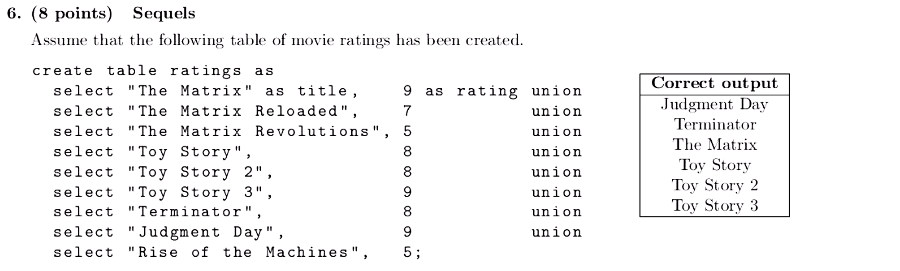
Select the titles of all movies that have a rating greater than 7 in alphabetical order.
SELECT title FROM ratings WHERE rating > 7 ORDER BY title;

Slide 8
Table Joins
Allows us to compare rows in different tables
Computes cross-product of the rows in the tables on either side of the join

Slide 9
Things to Remember!
Establish a relationship between tables with a condition in the WHERE clause, filtering out rows that don’t make sense
Need to alias columns if selecting a column name shared by multiple tables

Slide 10
Joins With Same Table
Imagine we have a table `nums` with one column `n` (on the left). We can join it with itself using select * from nums as a, nums as b; The joins table is on the right. We can then filter...
a | b
a.n | b.n
1 | 1
1 | 2
2 | 1
2 | 2
nums
n
1
2

Slide 11
Joins Two Separate Tables
straight_outta_compton
albums
real_name | stage_name
antoine carraby | dj yella
lorenzo patterson | mc ren
oshea jackson | ice cube
andrew young | dr dre
eric wright | eazy e
album | artist
i am the west | ice cube
eazy-duz-it | eazy e
compton | dr dre
reincarnated | mc ren
slice | dj yella
Q: Write a query that will output the real name of each member and his album in alphabetical order (by name).

Slide 12
Joins - Solution
straight_outta_compton
Q: Write a query that will output the real name of each member and his album in alphabetical order (by name).
albums
real_name | stage_name
antoine carraby | dj yella
lorenzo patterson | mc ren
oshea jackson | ice cube
andrew young | dr dre
eric wright | eazy e
album | artist
i am the west | ice cube
eazy-duz-it | eazy e
compton | dr dre
reincarnated | mc ren
slice | dj yella
A: SELECT m.real_name, a.album
FROM straight_outta_compton AS m, albums AS a
WHERE m.stage_name = a.artist
ORDER BY stage_name;

Slide 13
Aggregation
Operations you should know:
MAX - returns the max element of column or group.
MIN - returns the min element of a column or group.
COUNT - counts rows in column or group.
SUM - sums values of a column or group.

Slide 14
Aggregation works on Groups
counts all rows in the entire table:
SELECT COUNT(*) FROM candidates;
groups rows based on party and counts rows in each group:
SELECT party, COUNT(*) FROM ratings GROUP BY party;

Slide 15
Aggregation Problem
Q: Select the party name and the age of the oldest candidate in each party.
name | age | party | title
Bernie Sanders | 74 | democratic | senator
Martin O’Malley | 52 | democratic | former governor
Hillary Clinton | 68 | democratic | former s.o.s.
Ted Cruz | 44 | republican | senator
Tami Stanfield | 53 | independent | CS expert
Ben Carson | 64 | republican | doctor

Slide 16
Aggregation Solution
Q: Select the party name and the age of the oldest candidate in each party in increasing order.
A: SELECT party, MAX(age) FROM candidates GROUP BY party;

Slide 17
WITH ... AS
Create a temporary table using a WITH clause
Allows for recursive queries

Slide 18
Recursive Selects
Start off with a base case (select one or more rows to start off with)
Select a new set of rows for each of the previous rows we haven’t looked at yet.
Builds from the bottom up!

Slide 19
Simple Recursive Select Table
We want to build the tables from 0 to 10
with nums(n) as (
select 0 union
select n + 1 where n < 10
)
nums
n
0
1
...
10

Slide 20
(4 pt) A Hamming number is a positive integer that has no prime factors other than 2, 3, or 5. That is, all Hamming numbers are pow(2, i) * pow(3, j) * pow(5, k) for some non-negative integers i, j, and k. The first 20 Hamming numbers are 1, 2, 3, 4, 5, 6, 8, 9, 10, 12, 15, 16, 18, 20, 24, 25, 27, 30, 32, and 36. Complete the SQL statements below so that the final statement generates a single-column table that contains as its rows the Hamming numbers less than 100 in increasing order.
CREATE TABLE t AS SELECT 2 AS k UNION SELECT 3 UNION SELECT 5; WITH ham(n) AS ( SELECT ____________________ UNION SELECT ____________________ FROM ____________________ WHERE ____________________ ) SELECT n FROM ham ORDER BY n;
1
n * k
ham, t
n * k < 100

Slide 21
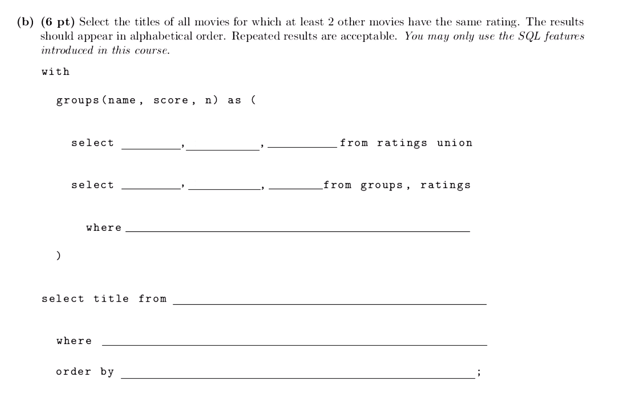
title | rating
The Matrix | 9
The Matrix Reloaded | 7
The Matrix Revolutions | 5
Toy Story | 8
Toy Story 2 | 8
Toy Story 3 | 9
Terminator | 8
Judgment Day | 9
Rise of the Machines | 5

Slide 22
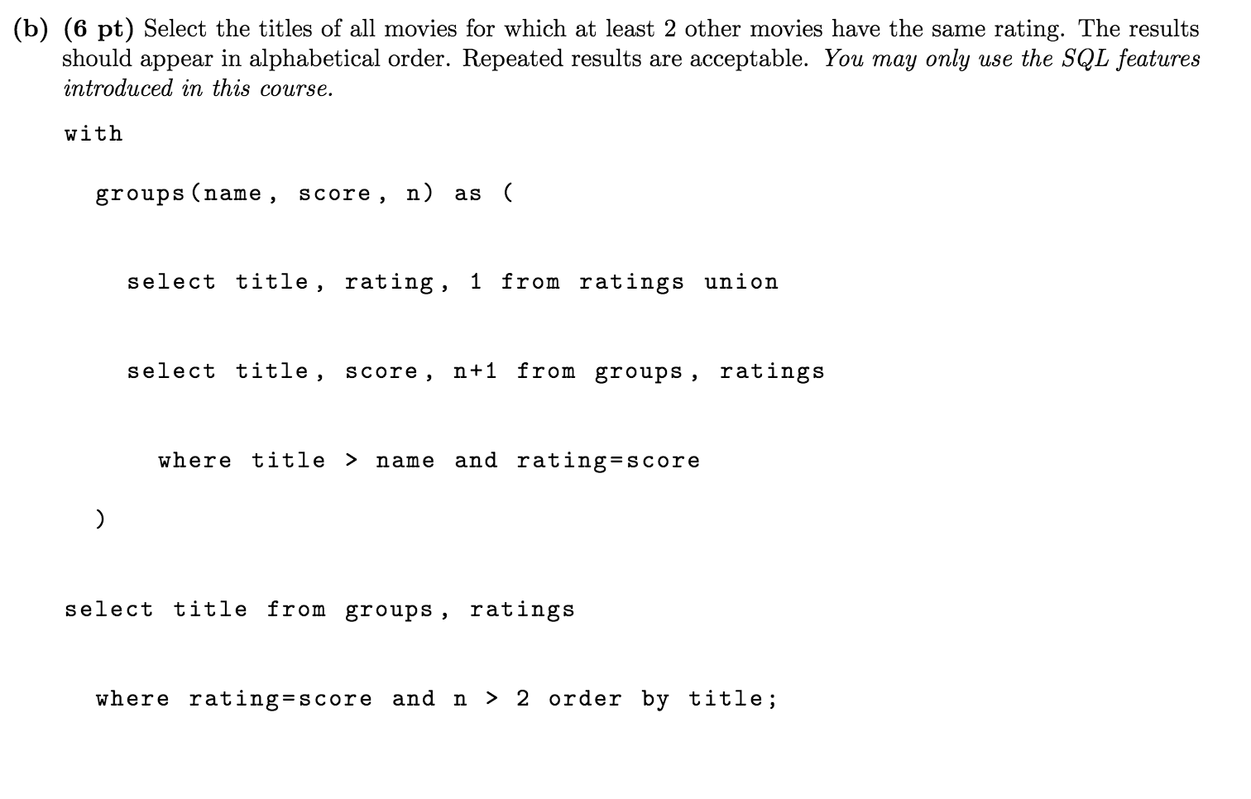
For another explanation check
Max Wolfe’s walkthrough here

